Slide 1

Project Presentation of CO-OP Project at Industry (Module-2) (22CS421)
on
A Deep Learning-Based Framework for
Autonomous Driving Software in Electric Vehicles
Llywellyn Sana Thaoroijam
2210991854
Supervised By
Dr. Simarjit Kaur
Associate Professor
Department of Computer Science and Engineering
Chitkara University, Punjab

Slide 2
Agenda
1
Introduction
5
Tools & Technologies
2
Problem Statement
6
Results & Discussion
3
Objectives
7
Conclusion & Future Scope
4
Methodology
2

Slide 3
Introduction
Autonomous driving is one of the most impactful AI applications in modern transportation.
EVs need intelligent systems for safe, efficient, and autonomous navigation — especially in unstructured environments like Indian roads.
Perception
Decision-Making
Control
Object detection, lane detection, traffic signal recognition using CV & deep learning
Analyzing perceived data to determine the optimal driving path
Executing driving decisions via steering, acceleration, and braking
YOLOv8 + Canny Edge Detection + Polynomial Curve Fitting + Flask Web Interface — unified into a real-time autonomous driving framework for EVs.
3

Slide 4
Problem Statement
Unstructured Road Conditions
Fragile Perception Modules
Faded/missing lanes, mixed traffic (vehicles, pedestrians, animals), frequent traffic rule violations — common in India.
Object detection degrades under poor lighting, occlusion, and weather. Lane detection fails without clear markings.
Lack of Module Integration
No Real-Time Visualization
Existing systems treat detection, lane tracking, and path planning as isolated tasks — causing latency and coordination failures.
Most research is simulation-only with no user-facing interface for live testing and evaluation.
4

Slide 5
Objectives
01
Real-Time Object Detection
Implement YOLOv8 to detect vehicles, pedestrians, and traffic signals accurately under varied conditions.
02
Robust Lane Detection
Use Canny edge detection, ROI masking, and polynomial curve fitting to identify lane boundaries reliably.
03
Dynamic Path Planning
Generate a safe central driving path between detected lanes for navigation decision-making.
04
System Integration & Deployment
Unify all modules into a modular Flask-based web interface for real-time video processing and visualization.
5

Slide 6
Methodology
Dataset
& Preprocessing
Model
Architecture
Lane Detection
Pipeline
Training
Strategy
Deployment
& Evaluation
BDD100K subset
Resizing, normalization
Data augmentation
Custom CNN
Conv + Pooling layers
YOLOv8 integration
Grayscale + Gaussian
Canny edges + ROI mask
Polynomial curve fit
GPU acceleration
Batch processing
Acc/loss monitoring
Flask web interface
Local + live stream
35-55 FPS on GPU
Explainability Techniques: Feature Map Visualization | Saliency Maps | Grad-CAM Heatmaps
6

Slide 7
Tools & Technologies
Language
Deep Learning
Python 3.x
PyTorch · TensorFlow · Ultralytics YOLOv8
Computer Vision
Web Framework
OpenCV — edge detection, ROI masking, curve fitting
Flask — real-time video stream interface
Dataset
Hardware
BDD100K — 100K diverse driving scenes
NVIDIA GPU — 35-55 FPS inference speed
7

Slide 8
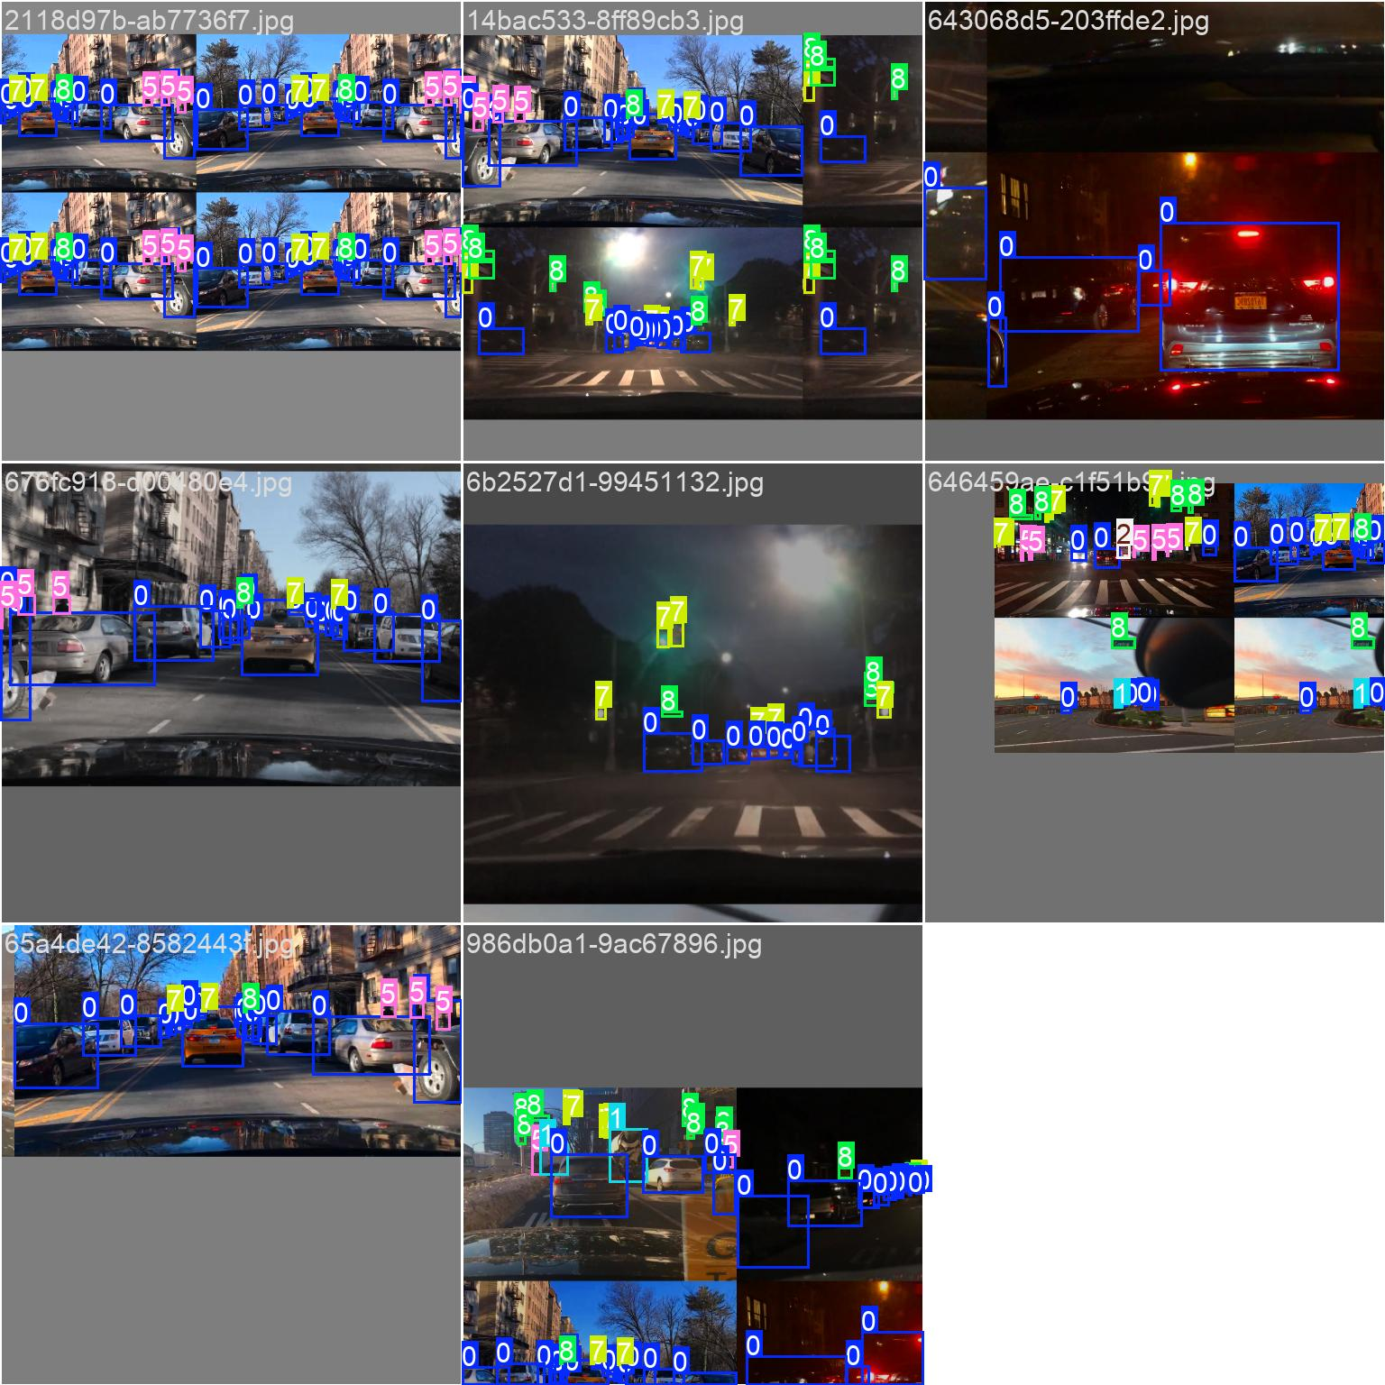
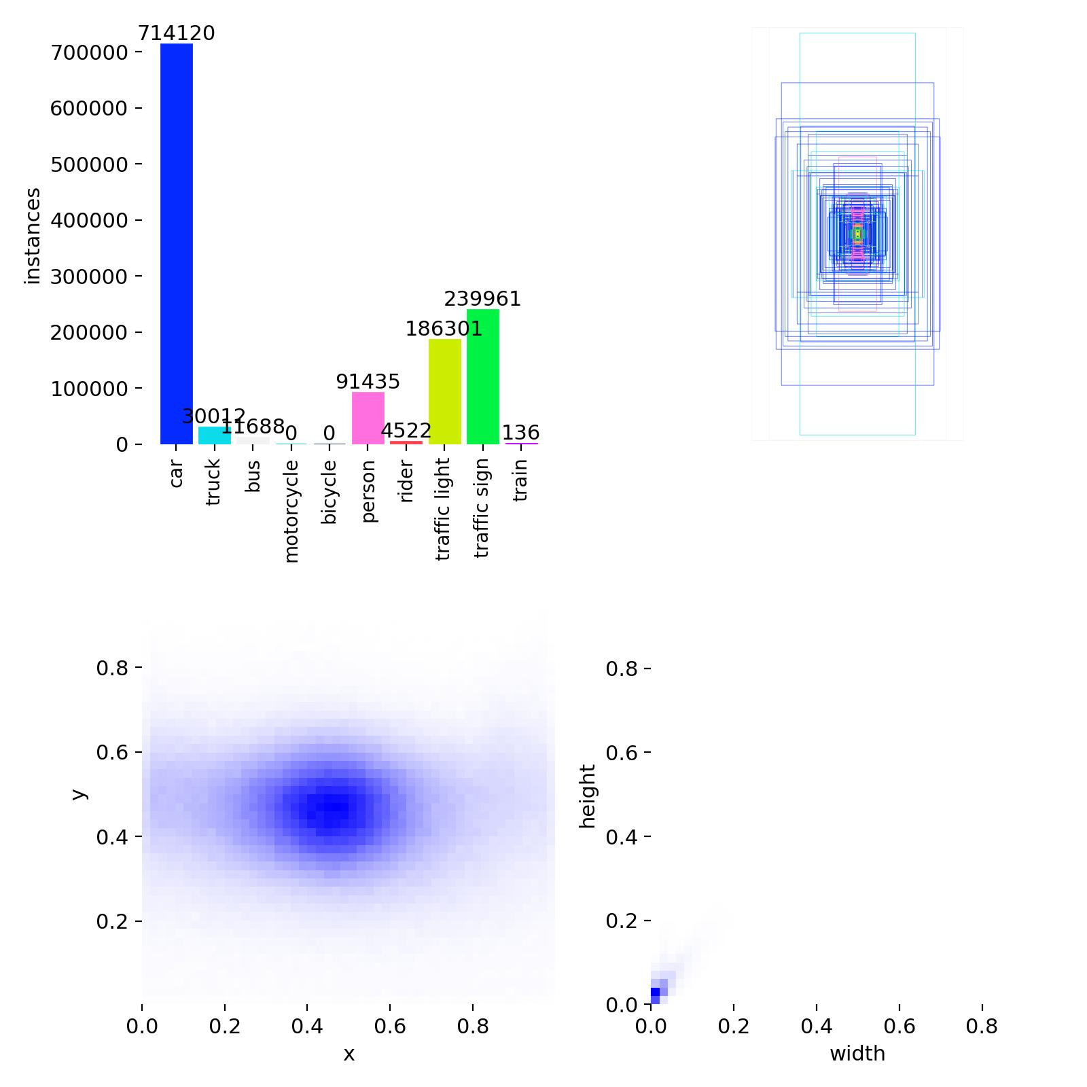
Results & Discussion — Training Data
Fig. 1: Training batch with bounding box annotations
Fig. 2: Dataset label distribution and bounding box statistics
8

Slide 9
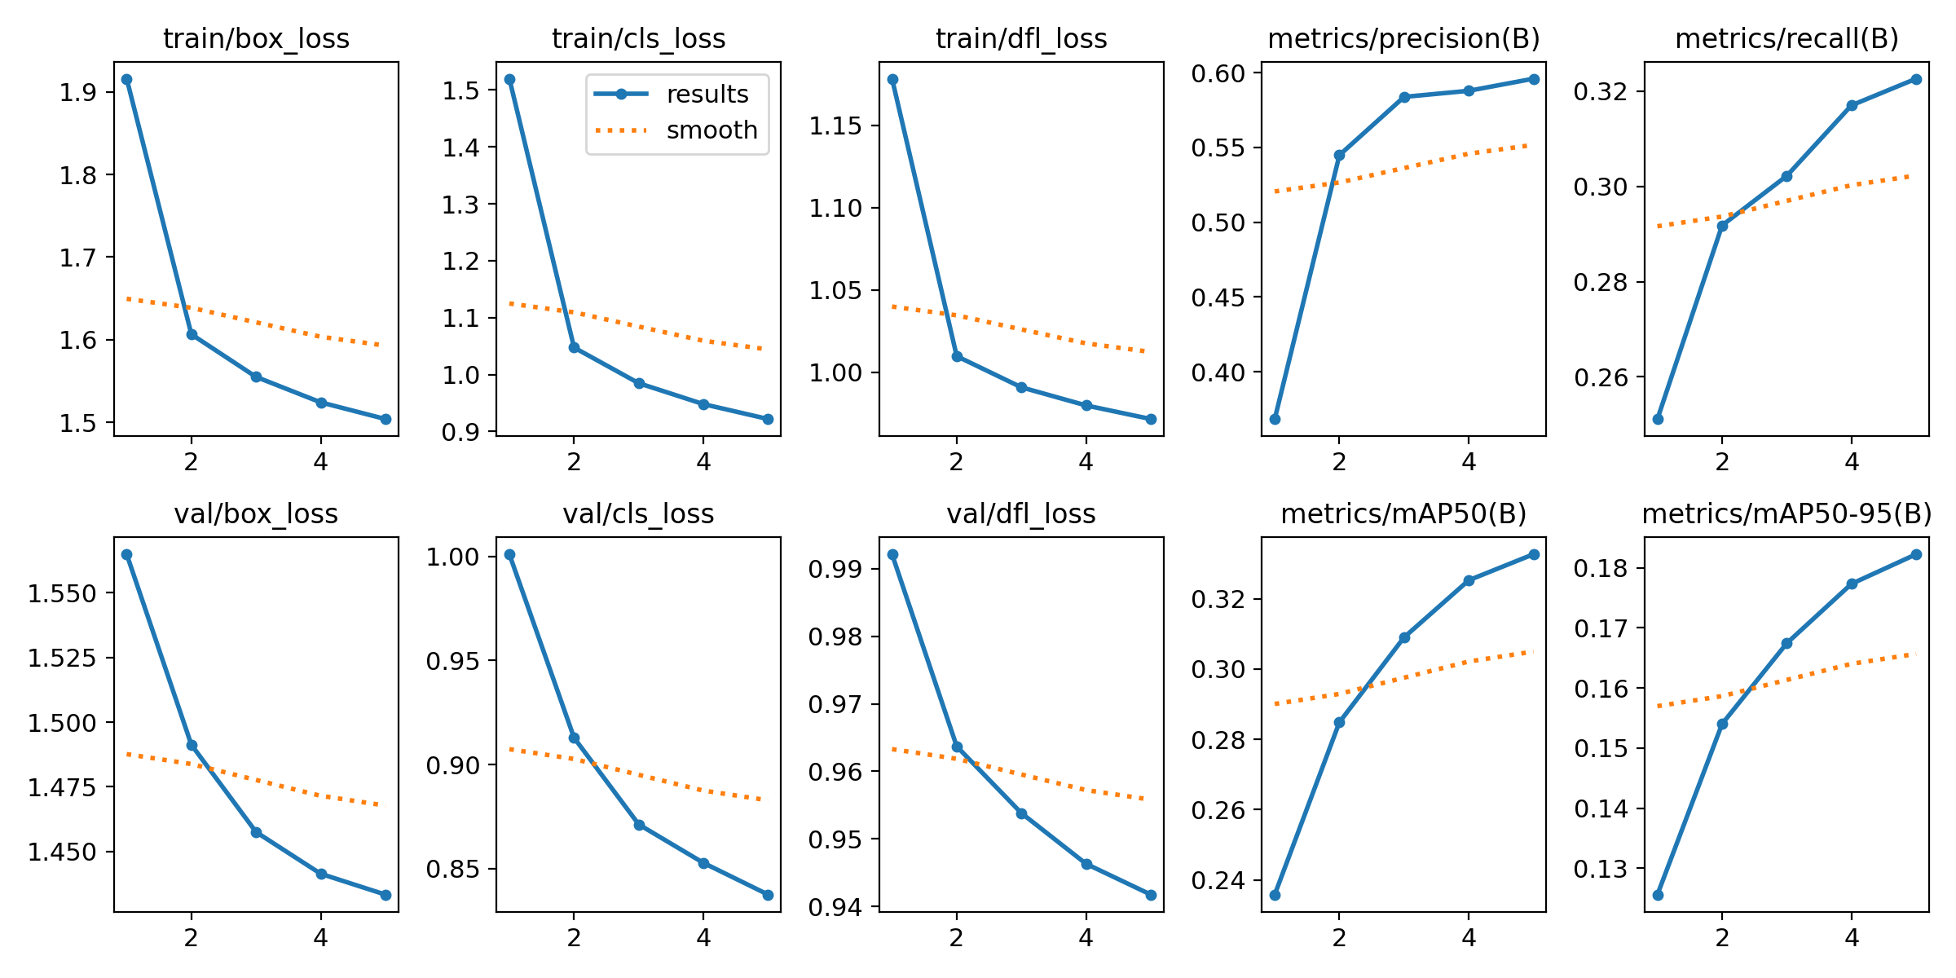
Results & Discussion — Training Performance
Fig. 3: Training & validation loss curves, precision, recall, mAP50 and mAP50-95 over 5 epochs
mAP50: 0.35
Precision: 0.60
Recall: 0.32
FPS: 35-55
9

Slide 10
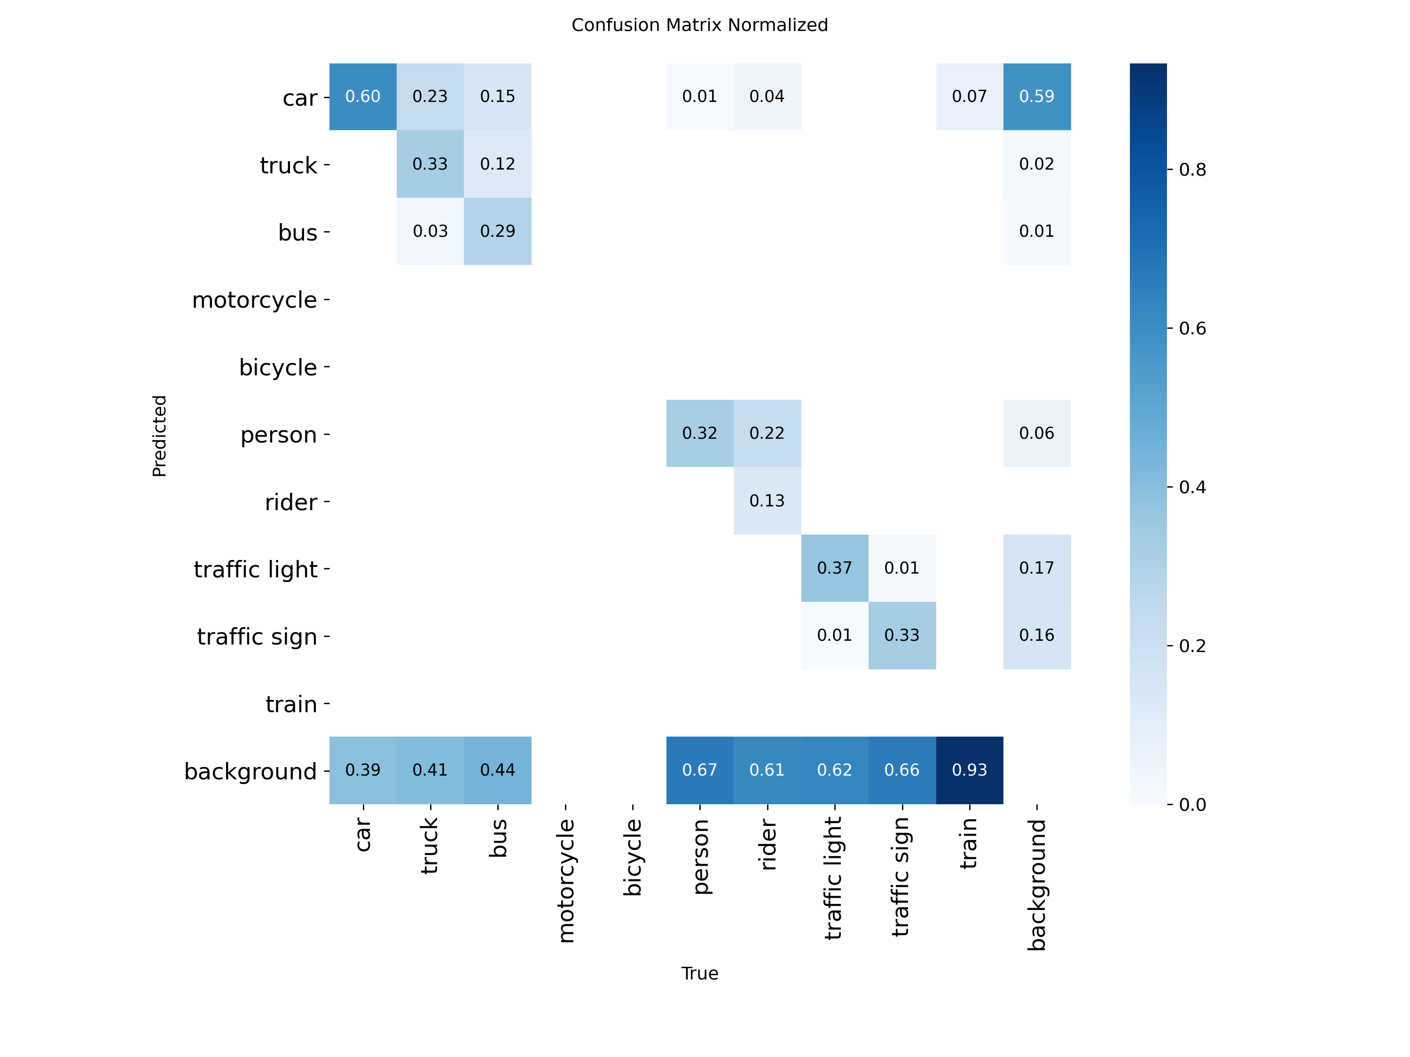
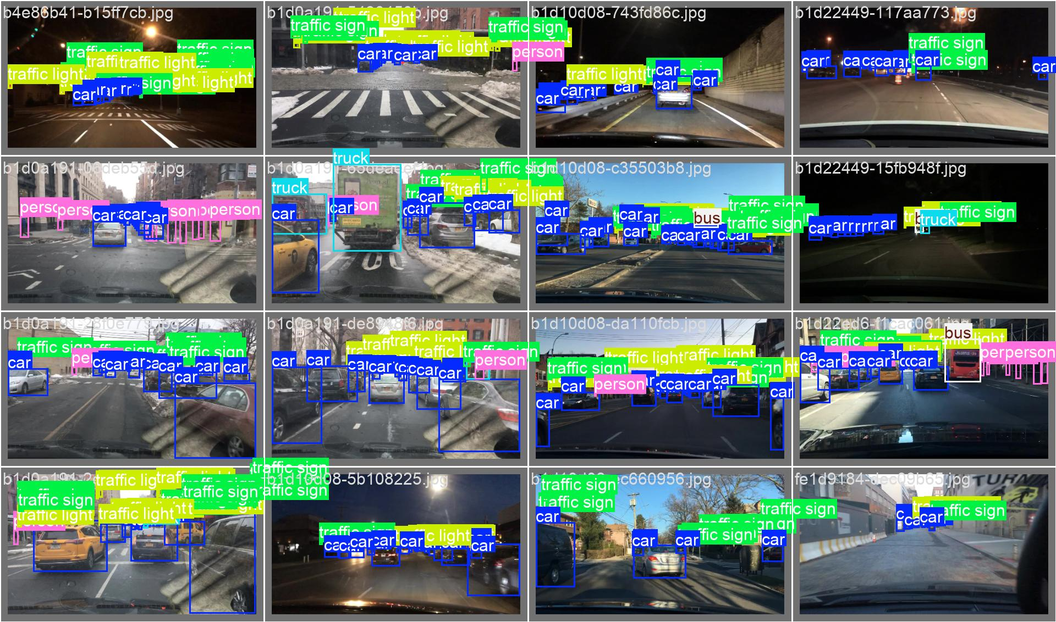
Results & Discussion — Detection Performance
Fig. 4: Normalized confusion matrix
Fig. 5: Validation batch predictions with labelled detections
10

Slide 11
Conclusion & Future Scope
Conclusion
Future Scope
✔ YOLOv8 detects vehicles, pedestrians & signals in real-time
✔ Lane detection with Canny + polynomial curve fitting
✔ Dynamic centre path generation for safe navigation
✔ 35–55 FPS on GPU — suitable for real-time deployment
✔ Flask interface for live video stream interaction
✔ Grad-CAM & saliency maps for model interpretability
→ Semantic segmentation for precise scene understanding
→ Sensor fusion — LiDAR, radar & GPS integration
→ Reinforcement learning for adaptive decision-making
→ Edge device optimization for embedded deployment
→ Expanded dataset with region-specific driving conditions
11

Slide 12

Thank You
Llywellyn Sana Thaoroijam | 2210991854
Supervised by Dr. Simarjit Kaur, Associate Professor
Department of Computer Science and Engineering, Chitkara University

